Slide 1
Progress
Everyday notes of Arefeh’s research

Slide 4
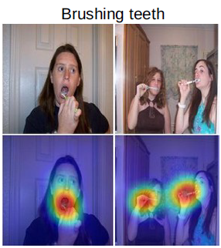
Two main methods in XAI for CNNs
Feb 2, 2022
Backpropagation-based
CAM: Class activation mapping → we need images to be input!
1. need specific architectures including pooling layers
2. highlights the regions in the input data that have the most influence
on CNNs output classification prediction
3. Can be used for time series
4. Identify the sub-sequences most relevant to any particular class
5. Article: Learning deep features for discrimination localizationLear
6. Article : Grad-CAM: Visual Explanations from Deep Networks
via Gradient-based Localization
atures for Discriminative Localization
‘Gradient*Input’ method used both for classification and regression tasks as it only needs the neurons activations to produce its explanations
Article: PatchX: Explaining Deep Models by Intelligible Pattern Patches for Time-series Classification(we need 1D time series data like texts)
Perturbation-based
Article: toward better understanding of gradient-based….
removing, masking, or altering them, running a forward pass on the new input, and measuring the difference with the original input
occlusion sensitivity method
Article:ConvTimeNet: A Pre-trained Deep Convolutional Neural Network for Time Series Classification
occluding parts of the time series and observing the changes in probability ^y for the predicted class
perform time series classification

Slide 5
Data mining based XAI models
Feb 2, 2022
Symbolic Aggregate Approximation (SAX)
transforms the time series into piece-wise aggregate approximation (PAA) representation
split into equal-sized segments which are computed by averaging the values of these segments
converts this representation into strings
can be applied on variable-length time series
perform time series classification
Fuzzy Logic
Article: The Prediction Algorithm Based on Fuzzy Logic Using Time Series Data Mining Method

Slide 6
Article: “Unsupervised Learning of Long-Term Motion Dynamics for Videos”
Feb 6, 2022
Representation -> predicts the sequence of basic motions (defined as atomic 3D flows)
Low dimention and easy to parametrizing: Quantizing the estimated 3D flows in space and time, referred to as atomic 3D flows
discriminative property: inferring a long-term sequence of 3D flows instead of a single 3D flow.
=> capture longer term motion dependencies
Then , the representation is used as feature motion for activity Recognition (using ConvLstm)

Slide 7
Article: DL discriminates better than SML
Feb14, 2022
A post hoc analysis by projecting the learnt DL1 embeddings (i.e., the output of the first fully connected layer in the DL1 architecture) onto a two-dimensional space using t-distributed stochastic neighbor embedding (t-SNE)54 for the entire range of training sample sizes, and color-coding the two-dimensional projection spectrum by the class labels.
Visualizing CNNs Using Saliency Maps

Slide 8
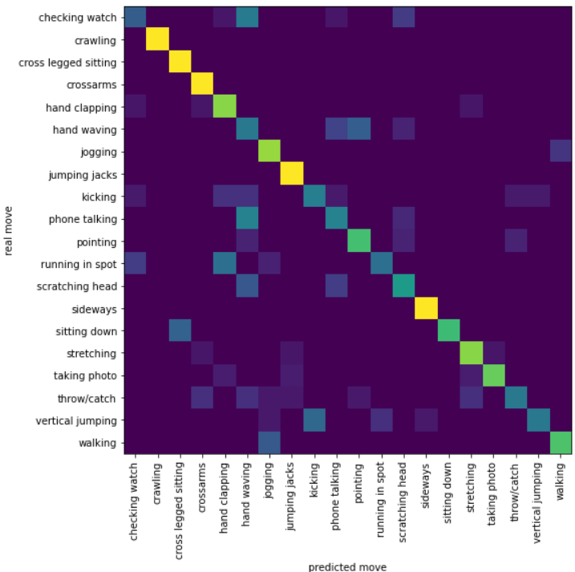
Confusion Mat for Padding method classification
Test Accuracy of the model on the test moves: 69.71%

Slide 9
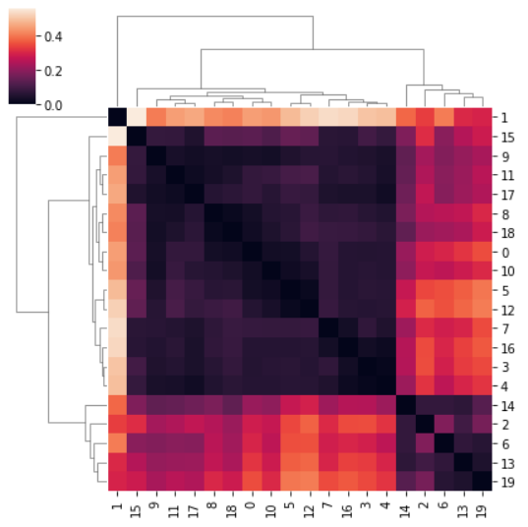
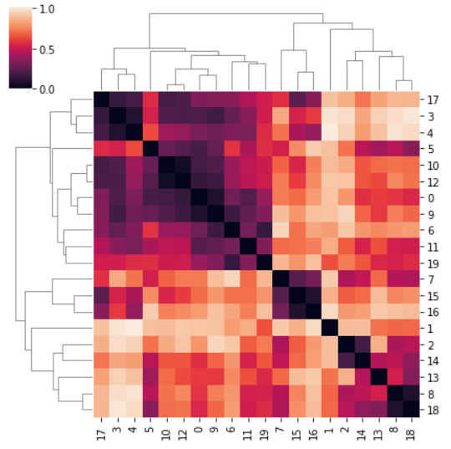
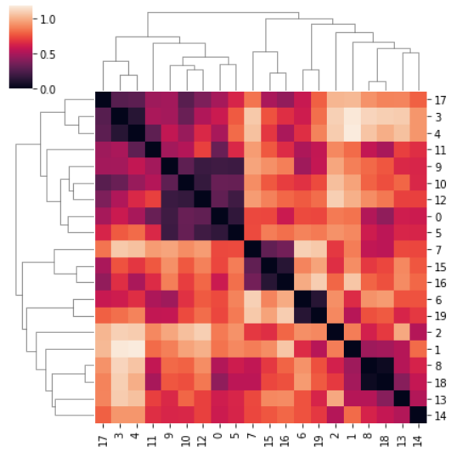
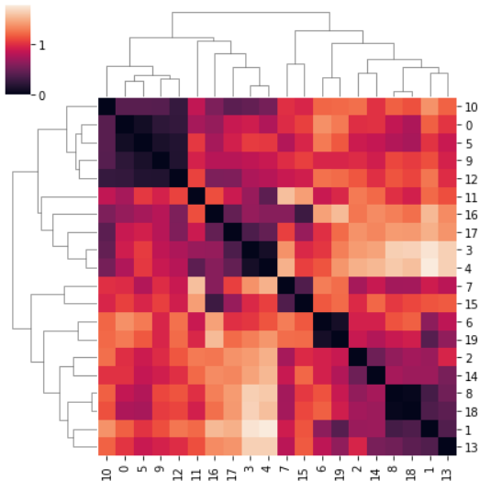
Apr25, 2022
0: 'checking_watch’
1: 'crawling’
2: 'cross_legged_sitting’
3: 'crossarms’
4:'hand_clapping’
5: 'hand_waving’
6: 'jogging’
7: 'jumping_jacks’
8: 'kicking’
9: 'phone_talking’
10: 'pointing’
11: 'running_in_spot’
12: 'scratching_head’
13: 'sideways’
14: 'sitting_down’,
15: 'stretching’
16: 'taking_photo’,
17: 'throw/catch’
18: 'vertical_jumping’
19: 'walking'
Input
FC1
FC2
FC3

Slide 10
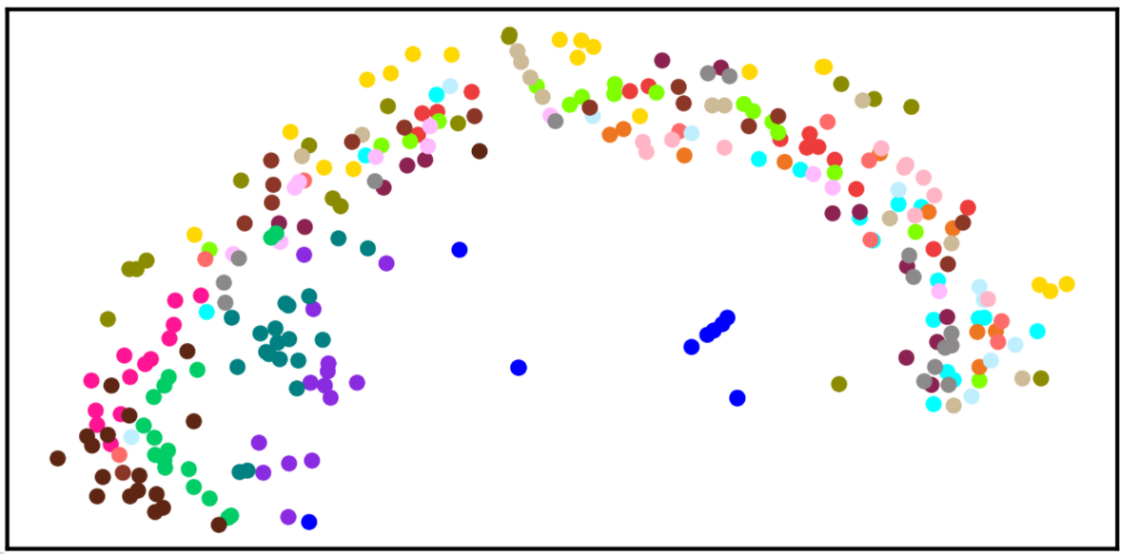
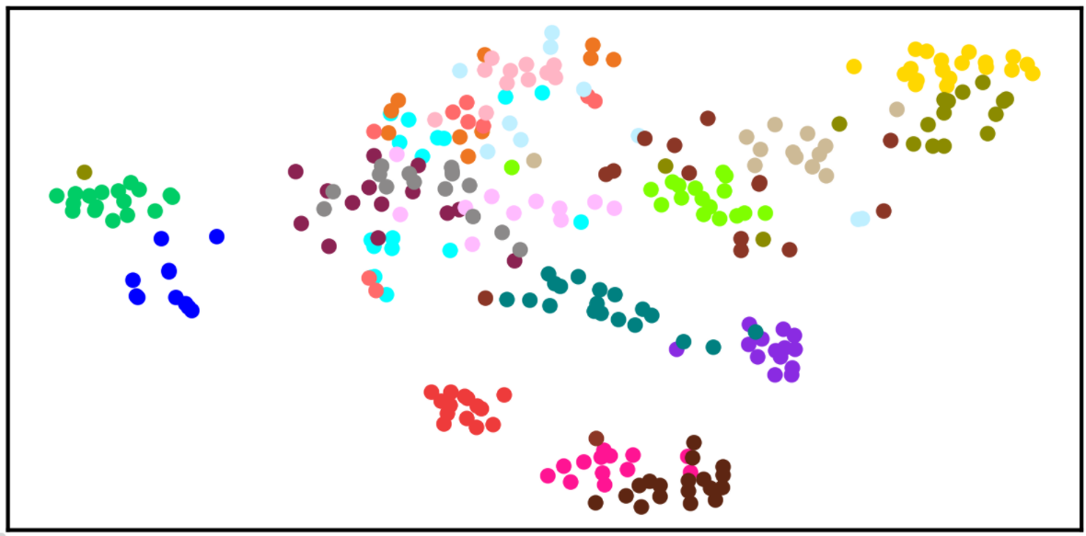
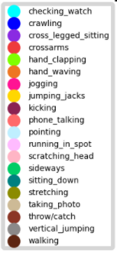
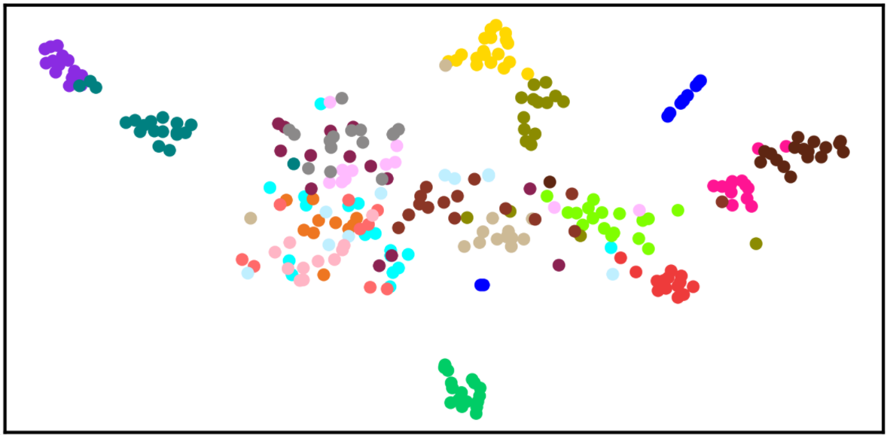
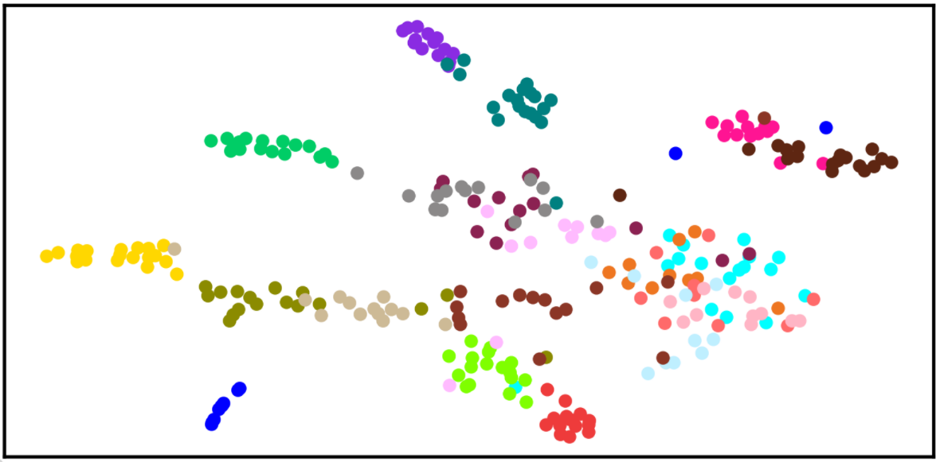
TSNE on test data

Slide 11
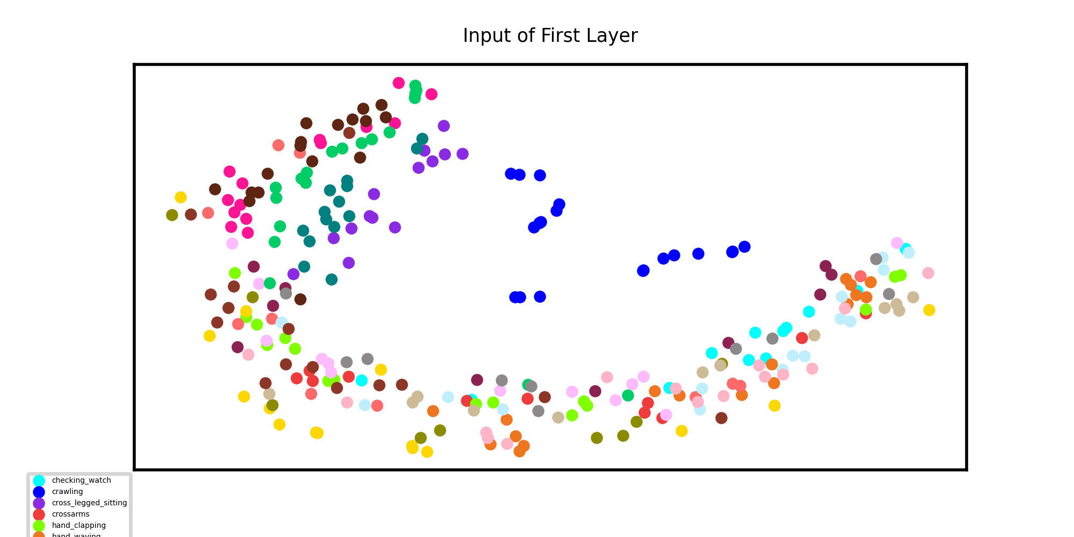
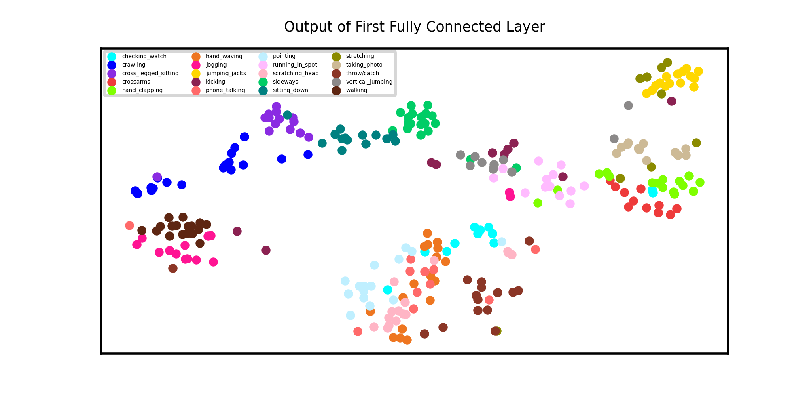
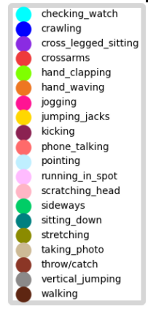
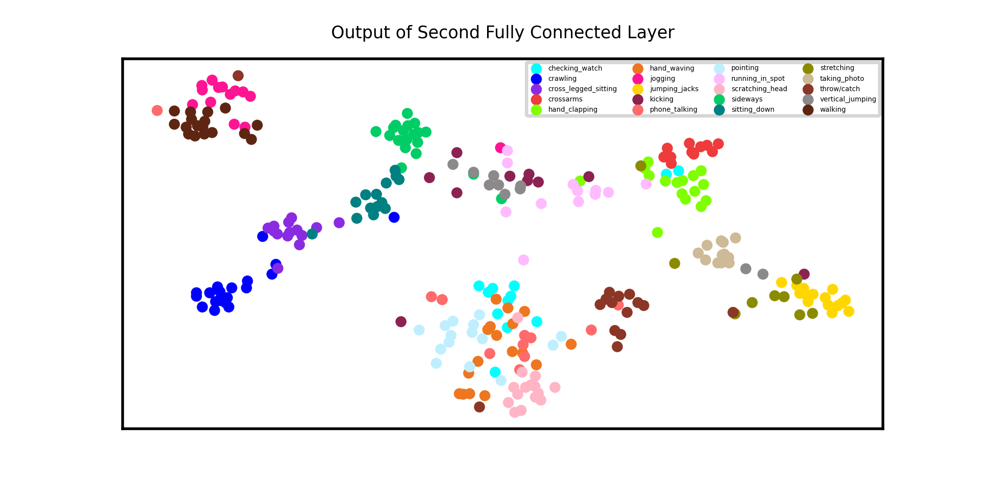
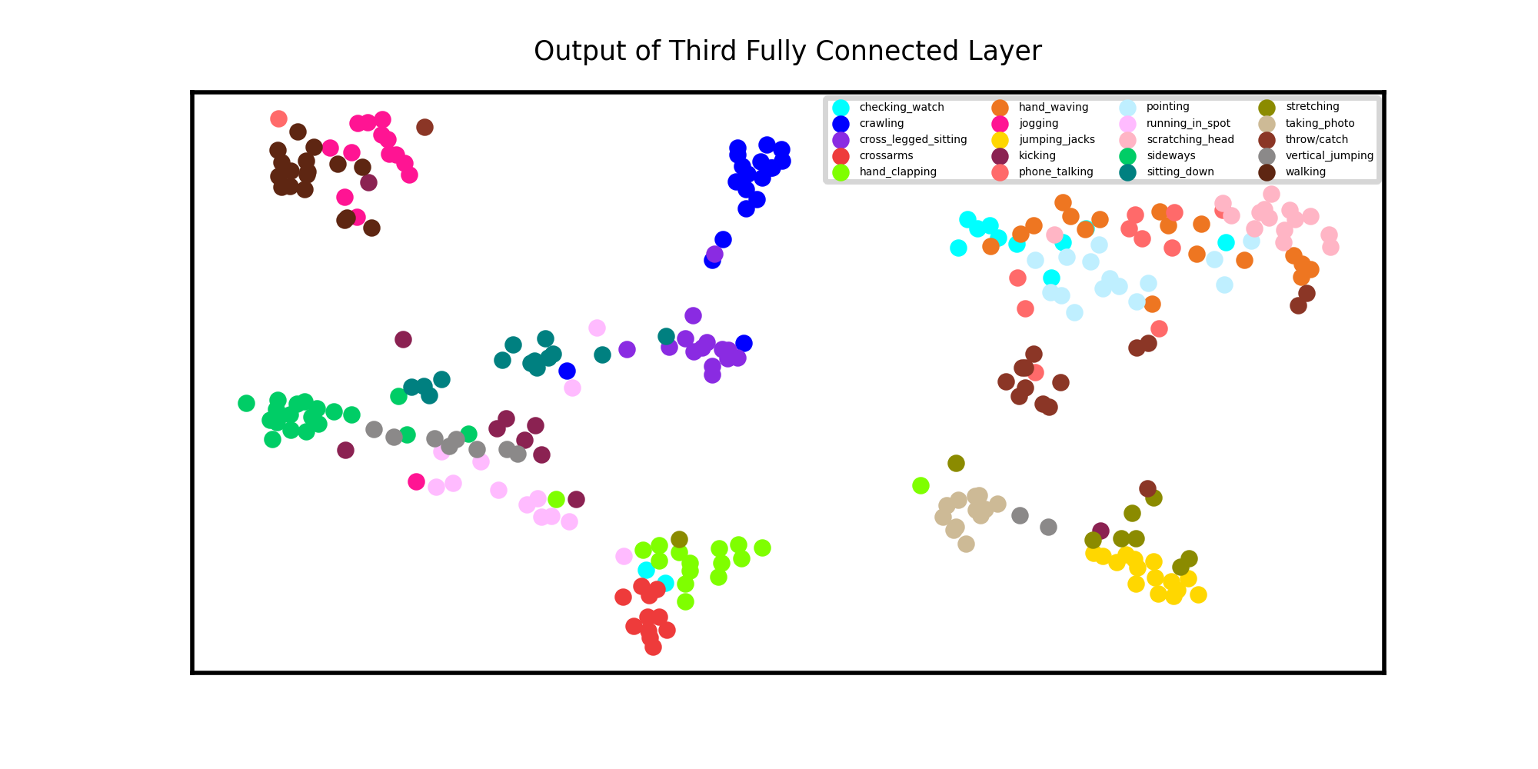
Discriminative analysis on training
DL learns meaningful brain representations that span a comprehensible projection spectrum. The t-SNE layouts of the learnt DL representations reveal meaningful refinement of the learnt patterns …… I want to add more fully connected layer

Slide 12
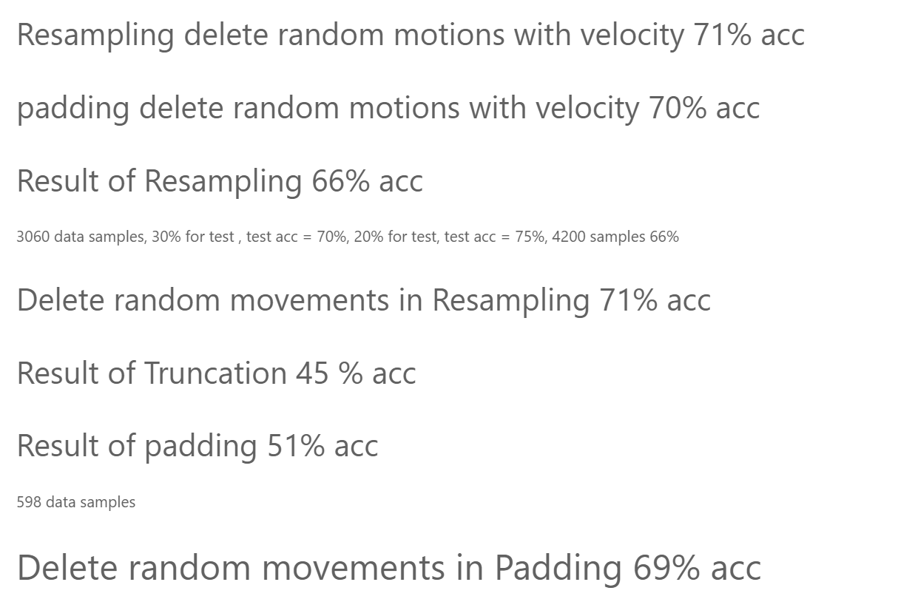
Review of previous results

Slide 13
Saliency Map
a saliency map will show us which pixels on the input image make the most impact on the output inferred by the network.
Find joints are more impressive?!
Find less important spots in videos
I should find a method that works on 1D conv not videos! Or we can work on videos without deeplabcut
Clustering algorithms
How different movement are clustered with each other without labels
How the clustering trajectory differs in different layers of neural network

Slide 14
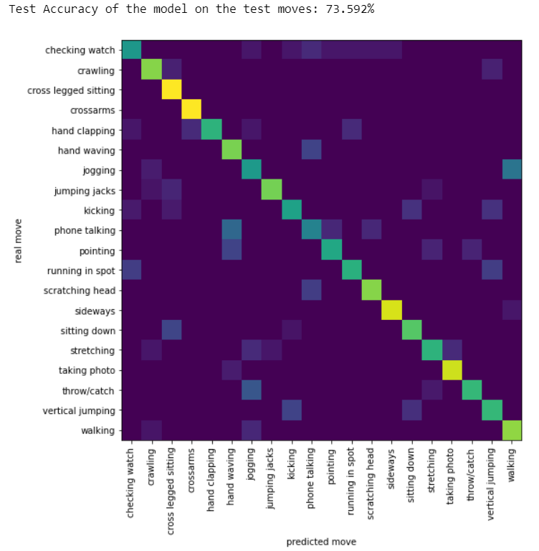
Interpolation
We want to slow motion all movements that have shorter length of movement using interpolation. So we should not pick points after the motion time, instead, we should expand the time!!!!

Slide 15
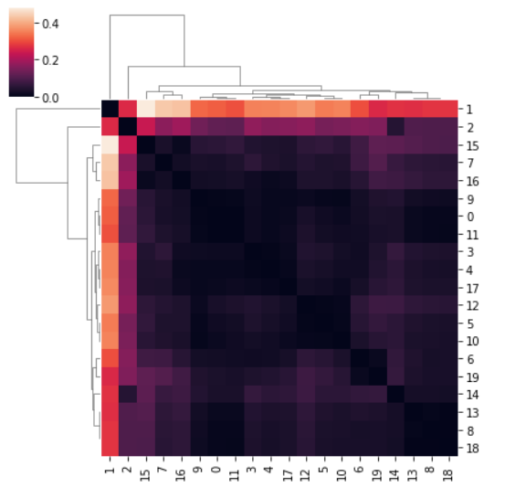
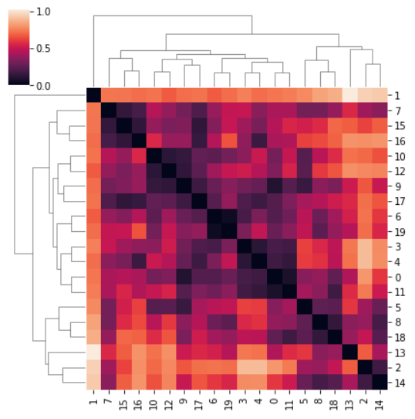
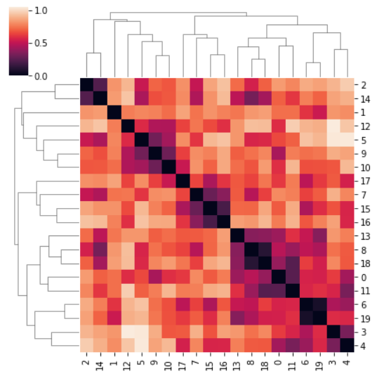
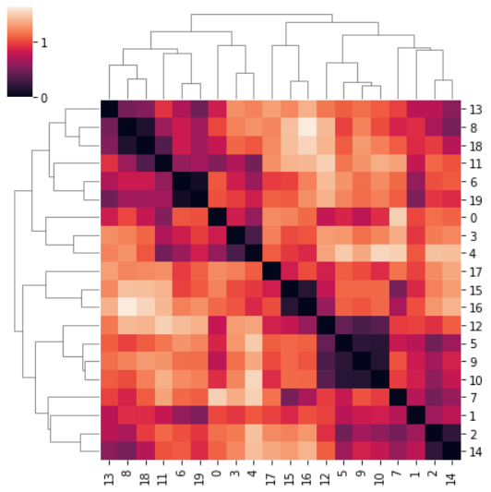
0: 'checking_watch’
1: 'crawling’
2: 'cross_legged_sitting’
3: 'crossarms’
4:'hand_clapping’
5: 'hand_waving’
6: 'jogging’
7: 'jumping_jacks’
8: 'kicking’
9: 'phone_talking’
10: 'pointing’
11: 'running_in_spot’
12: 'scratching_head’
13: 'sideways’
14: 'sitting_down’,
15: 'stretching’
16: 'taking_photo’,
17: 'throw/catch’
18: 'vertical_jumping’
19: 'walking'
Input
FC1
FC2
FC3

Slide 16
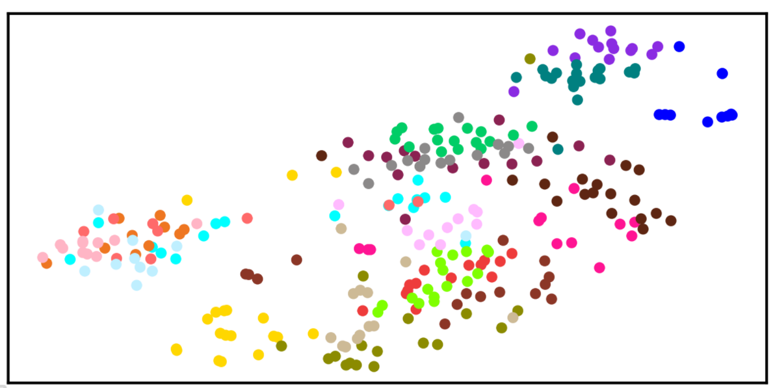
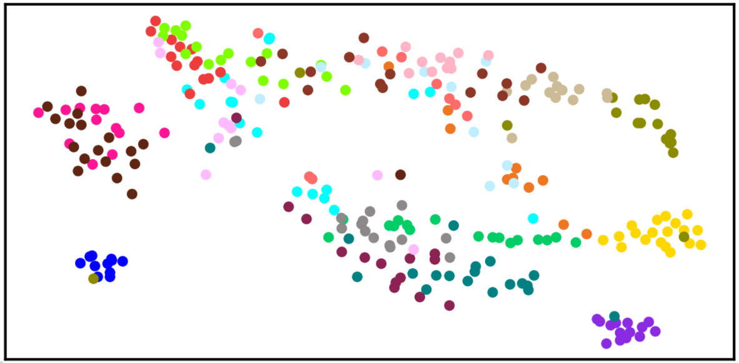
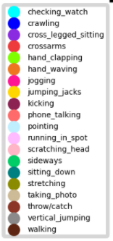
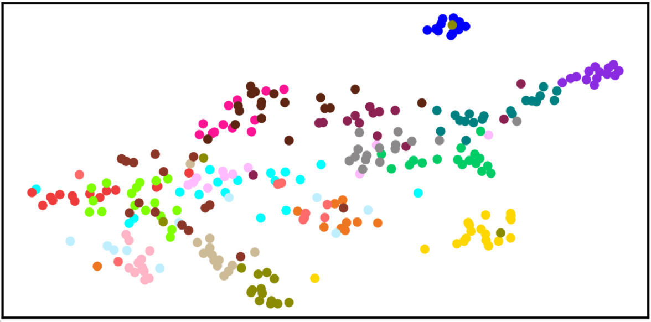
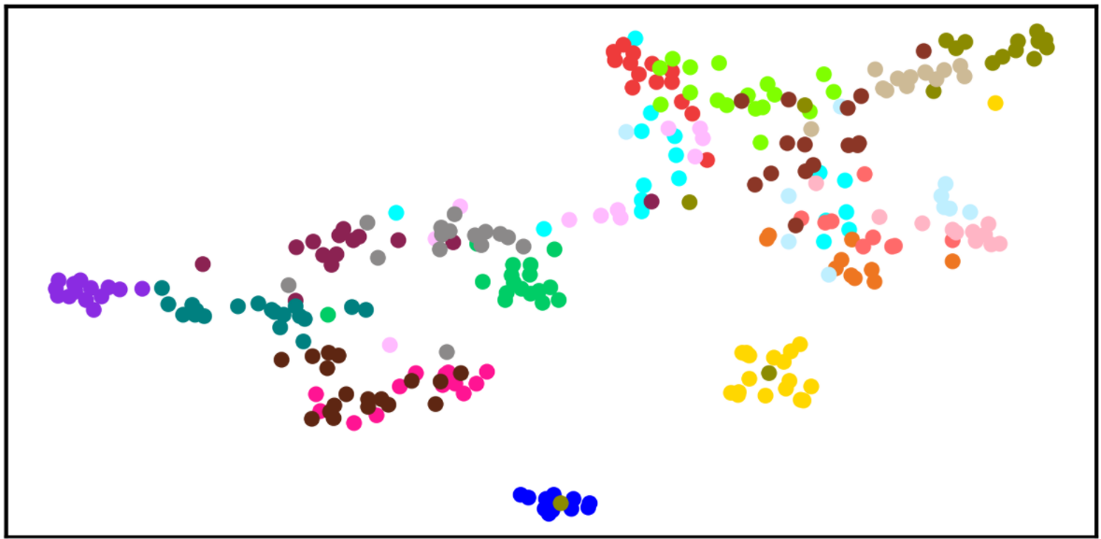
Discriminative analysis on test data

Slide 17
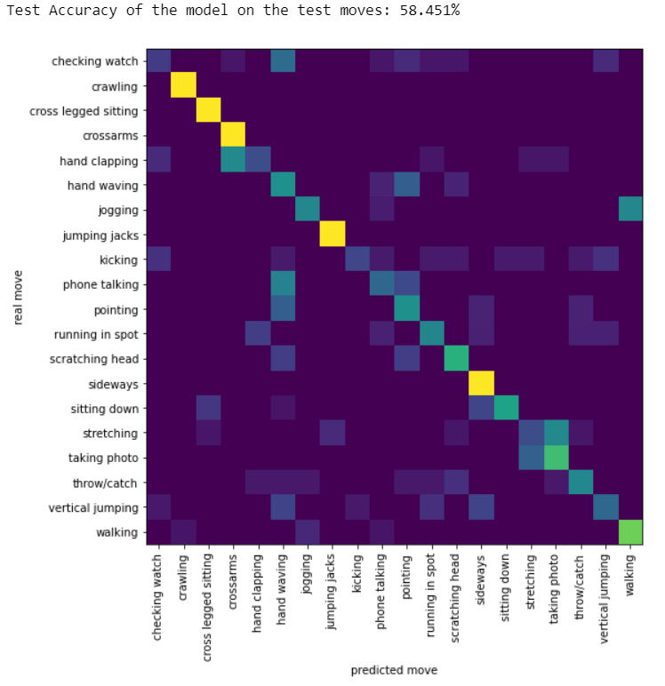
Freq Analysis
Freq = 100sin0.3x added to both knee and shoulder

Slide 18
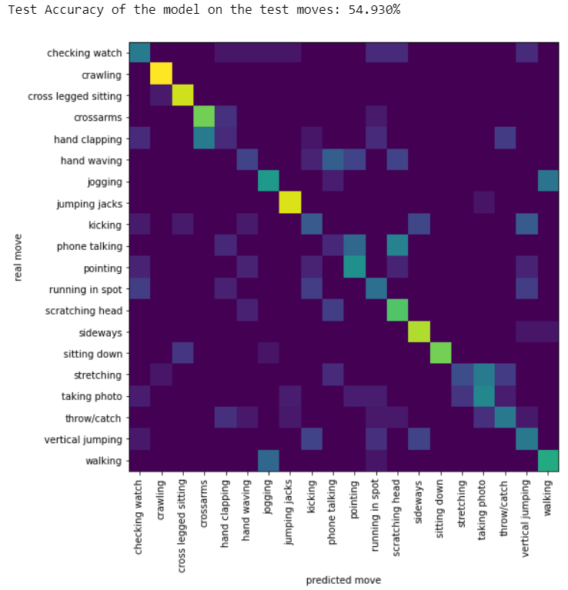
Freq Analysis
Freq = 100sin0.7x added to both knee and shoulder

Slide 19
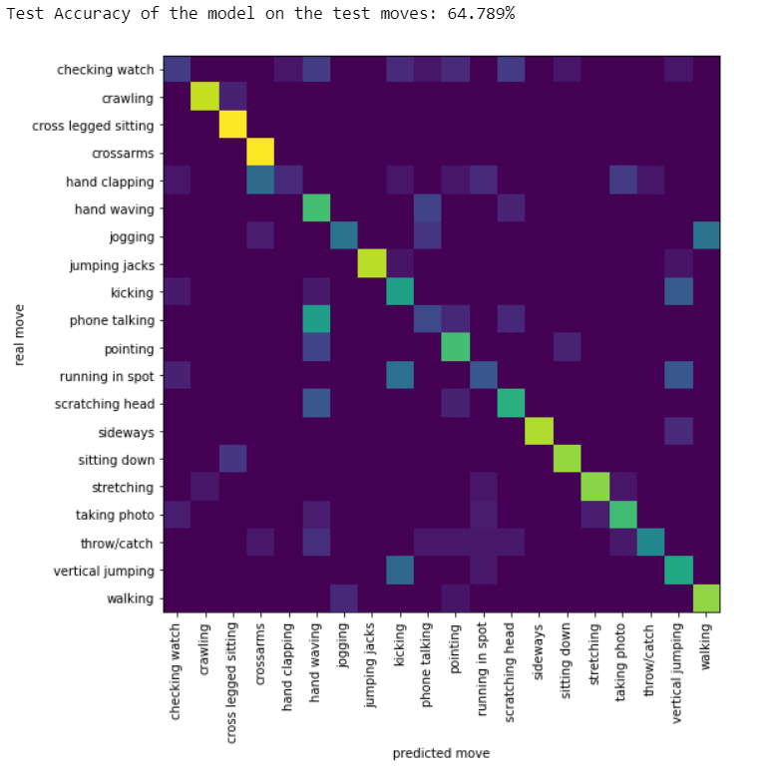
Freq Analysis
Freq = 100sin0.7x added to ankle

Slide 20
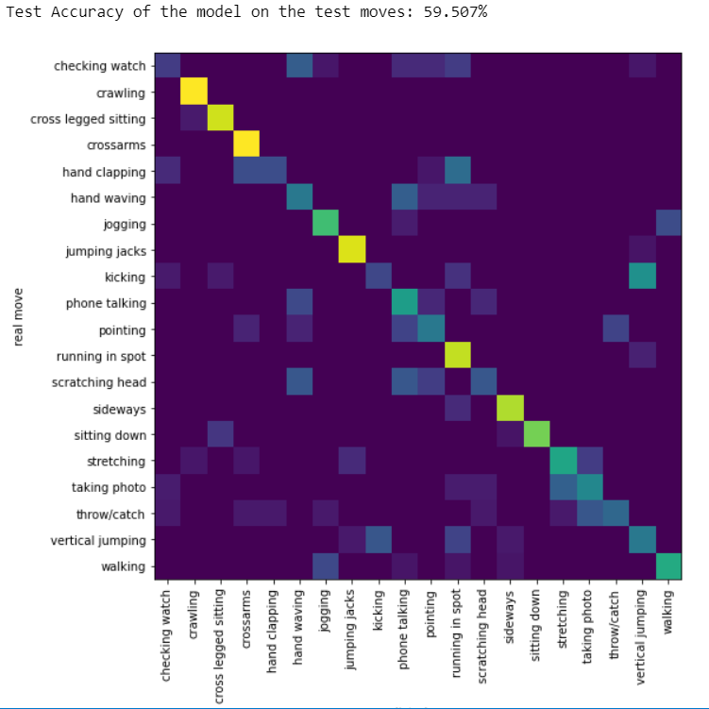
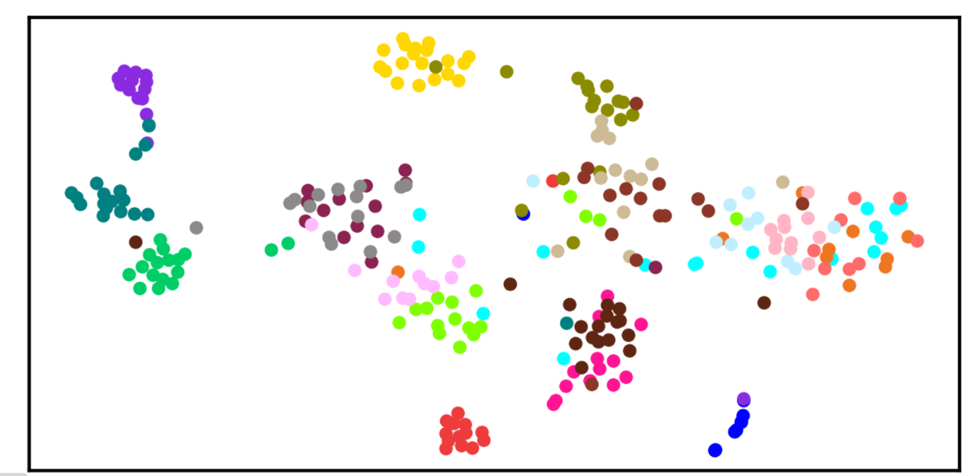
Freq Analysis
Freq = 100sin0.2x added to ankle
Vertical jumping and kicking are mixing together while they have
been separated before!

Slide 21

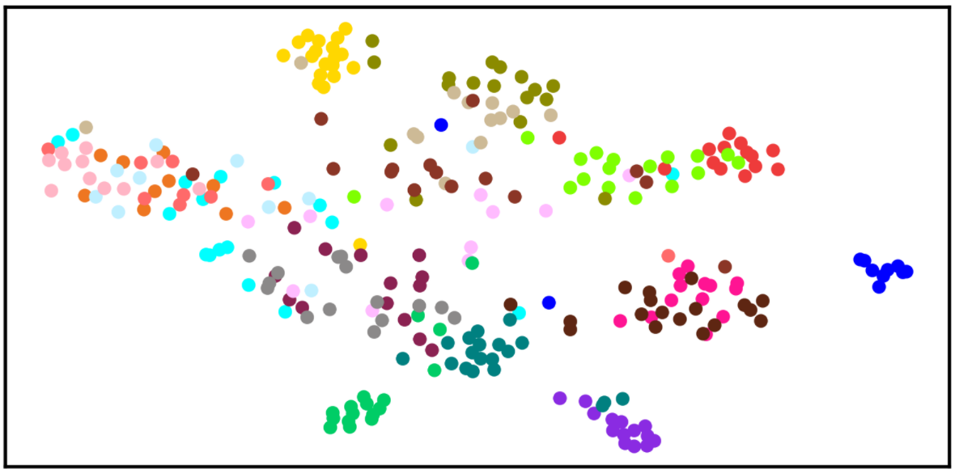
Freq Analysis
Freq = 100sin0.3x added to wrist

Slide 22
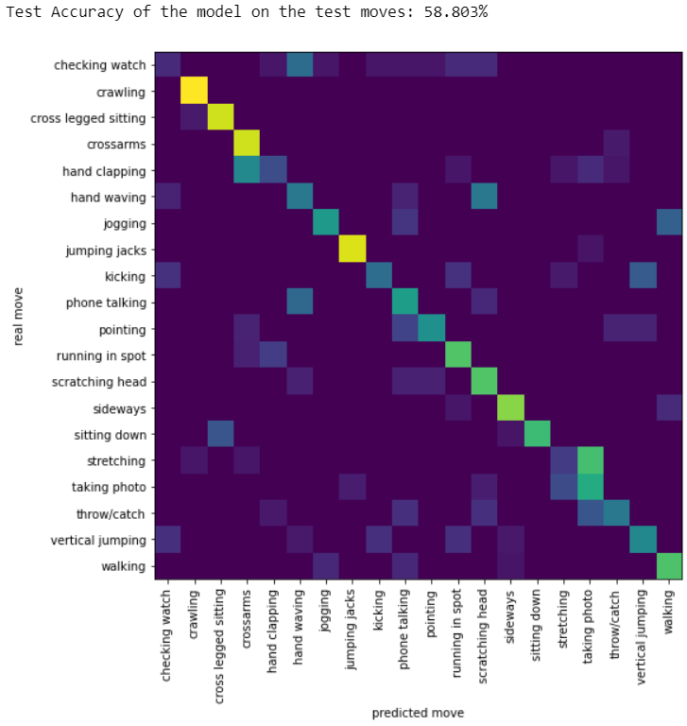
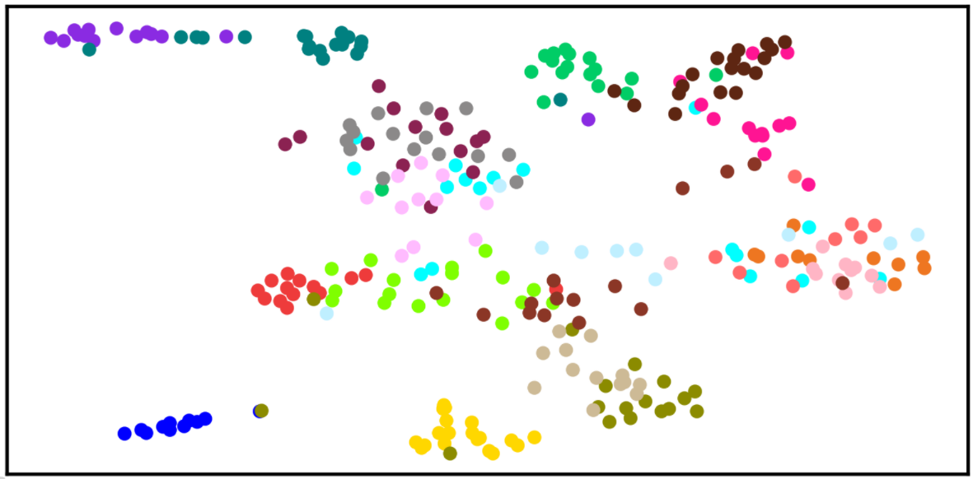
Freq Analysis
Freq = 100sin0.8x added to wrist
Siting down has been classified

Slide 23
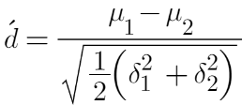
Effectiveness analysis by perturbation
Calculating this for all motions with presence of all different range of freqs and also giving 0 value instead of all different joints.
https://eshedmargalit.com/dprime_calculator/

Slide 24
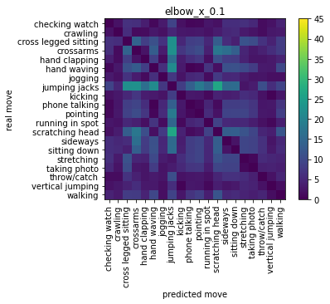
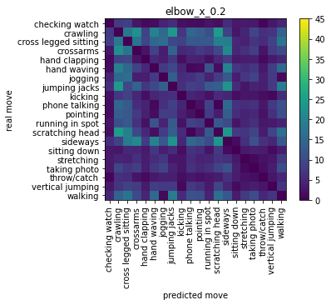
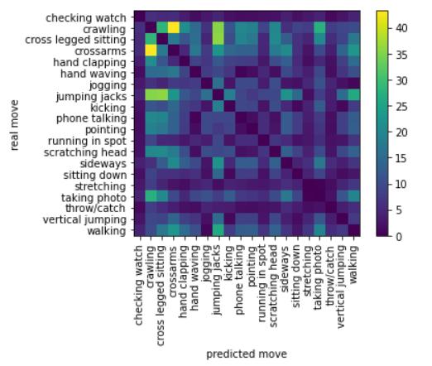
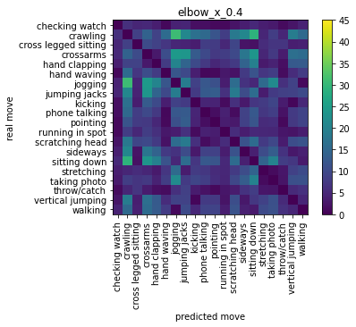
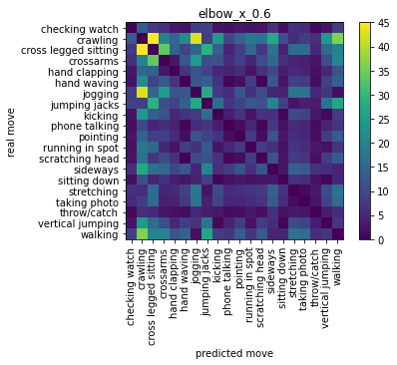
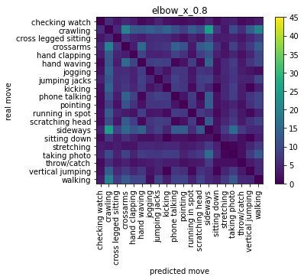

Slide 25
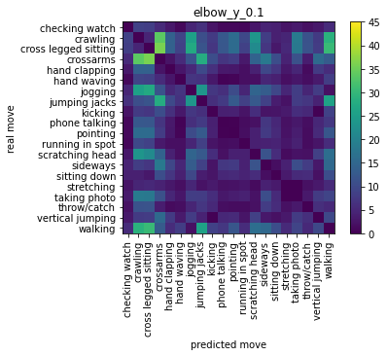
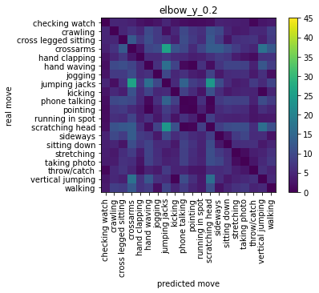

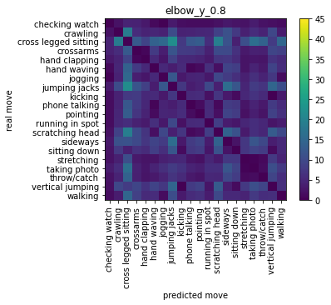


Slide 26


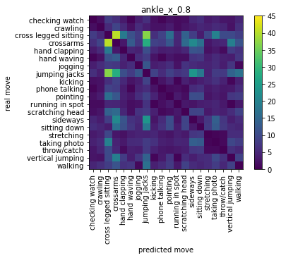



Slide 27
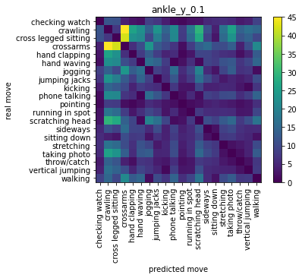


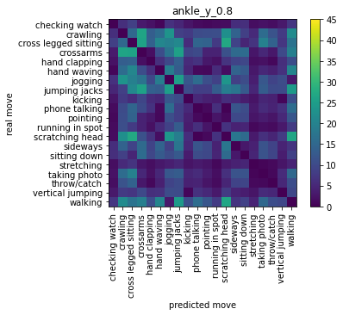


Slide 28
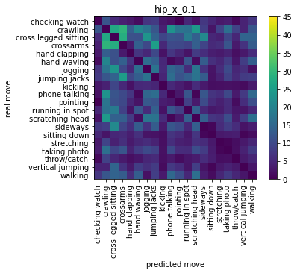
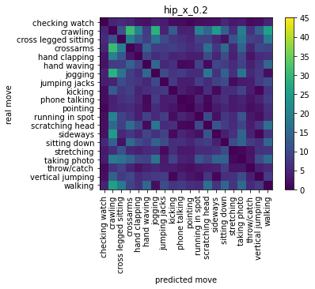




Slide 29






Slide 30






Slide 31






Slide 32






Slide 33




Animations Analysis
Does the model fool or comprehend the movements as humans do?
Variables:
Amplitudes
Frequency
Joints
1- two class “walking” & “jumping jacks”:, perturb one specific joint
Freq
 | 0.2 | 0.5 | 0.8
20 | 100 | 100 | 100
30 | 100 | 100 | 100
80 | 100 | 100 | 100
amp

Slide 35

Multisensory integration
Using different Modulations/gain fields/
A model with the same sensory input but to produce different motor command into different limbs like reach or saccade
recurrent NN structure / lsm / OFC model
Coordinate transformation: mechanisms, what if we can also build a system handle different coordinate to produce motor command, necessity of this transformation in different levels of presentation
Cisek, Paul,Neural mechanisms for interacting with a world full of action choices

Slide 36

2. Sensory-motory encoding disassociation(Richard Anderson – Alexander Gail)
Reach/antireach task and how this disassociation happens in LIP-PRR regions.
Model simulation What if we can recognize or design a model which has two kind of input/output like the model in paper visual and contextual info.

Slide 37




Sensory-motory encoding disassociation
context-specific visuomotor transformations
Both implemented a gain-modulatory mechanism
for context integration but converged onto different
predominant encoding schemes.
Brozovic´ et al. Contextually Guided Visuomotor Transformations
A particular output unit is active every time the remapped position of the visual target falls within the preferred 1D tuning direction of the unit. For example, the fifth output unit has its preferred
direction at 0°. This means that when the remapping rule dictates 90° clockwise rotation, only visual targets that are positioned in the vicinity of 90° will excite this neuron.

Slide 38





Slide 39
Subject 1 How NN solve movement comprehension? Does it have any hierarchical stages? Does it build any shared pattern for movements? Does it process the same movement similarly?
Rehabilitation/ diagnosis
Train NN on different Dataset with specific abnormalities.
ML analysis
Design a Pipeline which uses Video-recorded data
Define a measurement or a score for normal or healthy movement which can distinguish abnormality
compare NN performance to human behavior in which they comprehend movement
If NN undrastand or fool in a same way which humans do
Recognition of characteristics joints for each movement

Slide 40



Subject 2 How different transformation is made in the brain to produce different motor commands? Does the same process is running for goal-directed gaze and reach movement? Can we combine/ensemble two models meaningfully to do this two different task at the same time? Does the model need extra stage or level or layer? Which approach should be considered?
Saccade
Reach

Slide 41


Saccade
Reach
Eye position (efference copy)
Retinal error (target location)
….
Hand position
Target position
Gain modulation
Position-dependant shifting in RF
Design a model with the same sensory information(visual/ proprioception) but two different output
(one in shoulder-centered Ref -> reach,
one in eye-centered Ref -> saccade)
Which structures should remain, and which should be altered!
What does happen for Neural population dynamic during reach and saccade
Reference Transformation( translation and rotation) in both reach and saccade
Can we have a indicator input the specifies the task(rule input)

Slide 42
Research Plan | Research Plan | 2022 |  |  |  |  |  |  |  |  |  |  |  | 2023 |  |  |  |  |  |  |  |  |  |  |  | 2024 |  |  |  |  |  |  |  |  |  |  |  | 2025
subject | Month | J | F | M | A | M | J | J | A | S | O | N | D | J | F | M | A | M | J | J | A | S | O | N | D | J | F | M | A | M | J | J | A | S | O | N | D | J | F | M | A | M | J | J | A | S | O | N | D
Subject 1: ANN project
Freq perturbation
Another(abnormal) dataset
Model interpretation- Score definition
Writing draft for publication in ML journal/ finalize github project
Subject 2
Literature review for model and the biological structure
Anti / pro saccade and reach
Neural population dynamic analysis for both saccade and reach
Finalize Model and the Results, Draft writing?!
Subject 3 ?
Committee meeting
Comprehensive exam
Thesis Defense
To be determined!

Slide 43
Oshiro 2011: Why normalization have been proposed?
Implications: 1- motion integration, 2- attentional modulations of neural responses
Extension of normalization: Our model extends the normalization framework to multiple sensory modalities, demonstrates that a simple set of neural operations can account for the main empirical features of multi-sensory integration and makes predictions for experiments that could identify neural signatures of normalization in multisensory areas.

